Slide 1
Bank Churn Rate: Current Status and Future Directions
TRAN QUANG NAM

Slide 2
Table of contents
01
02
03
04
05
Introduction
Exploratory Data Analysis
Data understanding & Data Preparation
Feature Selection
& Modeling
Results and future work

Slide 3
01
Introduction

Slide 4
Purpose of the Analysis
What is the Bank churn ?
Bank Churn refers to customers stopping their use of a bank's services and closing their accounts. This is critical for banks because retaining customers is often more cost-effective than acquiring new ones.
What is the purpose of this analyst ?
Identify Root Causes:
Understand why customers leave, such as poor service or better offers from competitors.
Improve Customer Retention:
Develop strategies to keep customers, like personalized offers and improved service.
Increase Profitability:
Retaining customers is more profitable than acquiring new ones.

Slide 5
— Jeffrey Hugh
"Winning back a lost customer is a chance to rebuild trust and create lasting loyalty."

Slide 6
02
Data Understanding & Data Preparation

Slide 7
2.1. Data understanding
440,833
Entries
11
2
Columns
Types of data
(float, object)

Slide 8
2.1. Data understanding
CustomerID : A unique identifier assigned to each customer.
Age : Age of customer
Gender : Gender of customer, typlically recorded as ‘Male’ and ‘Female’
Tenure : Number of years the customer has been with the bank
Usage Frequency : How offen the customer uses the bank’s services
Support Calls : The number of times the customer has contacted customer support.
Payment delay : The number of times that customer has delayed the payment
Subscription Type: The type of subscription or account the customer holds (e.g., basic, premium).
Contract Length: The length of the customer’s contract with the bank, often categorized (e.g., 1 year, 2 years).

Slide 9
2.1. Data understanding
10. Total Spend : Amount of money customer spent on bank service
11. Last Interaction: The time since the last interaction or transaction the customer had with the bank.
12. Churn: Indicates whether the customer has churned (left the bank) or not. 1 means the customer has churned, and 0 means they have not.

Slide 10
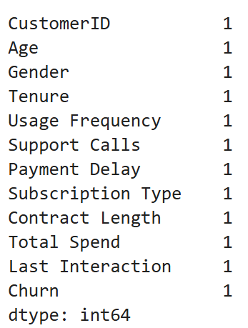
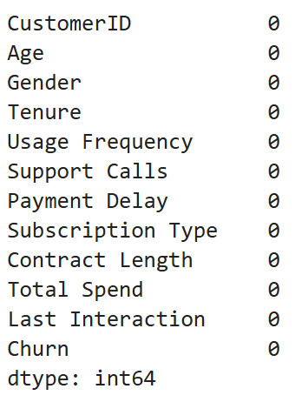
2.2. Data Preparation
In this part, we need to find out all the NA values, duplicate values and outliers
Handle the NA values
Seem like there is 1 NA values from all the columns.
This amount is to small so we drop it

Slide 11
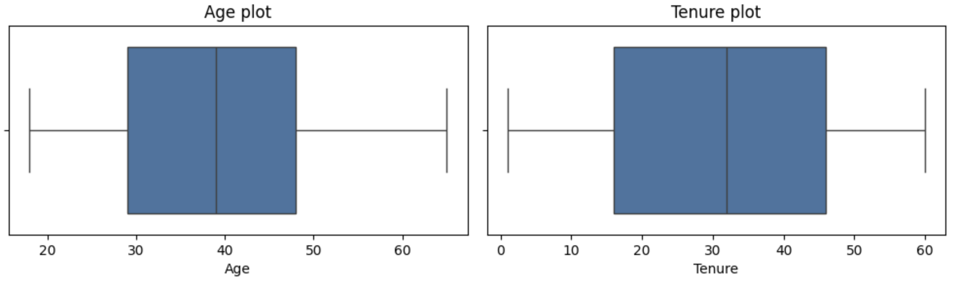
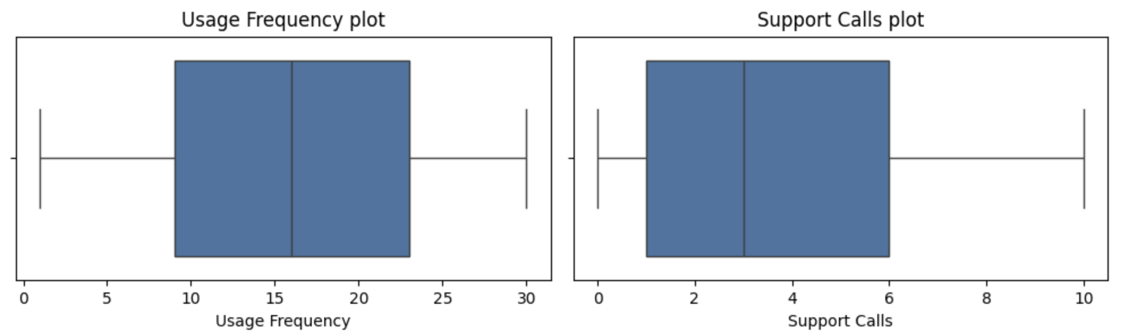
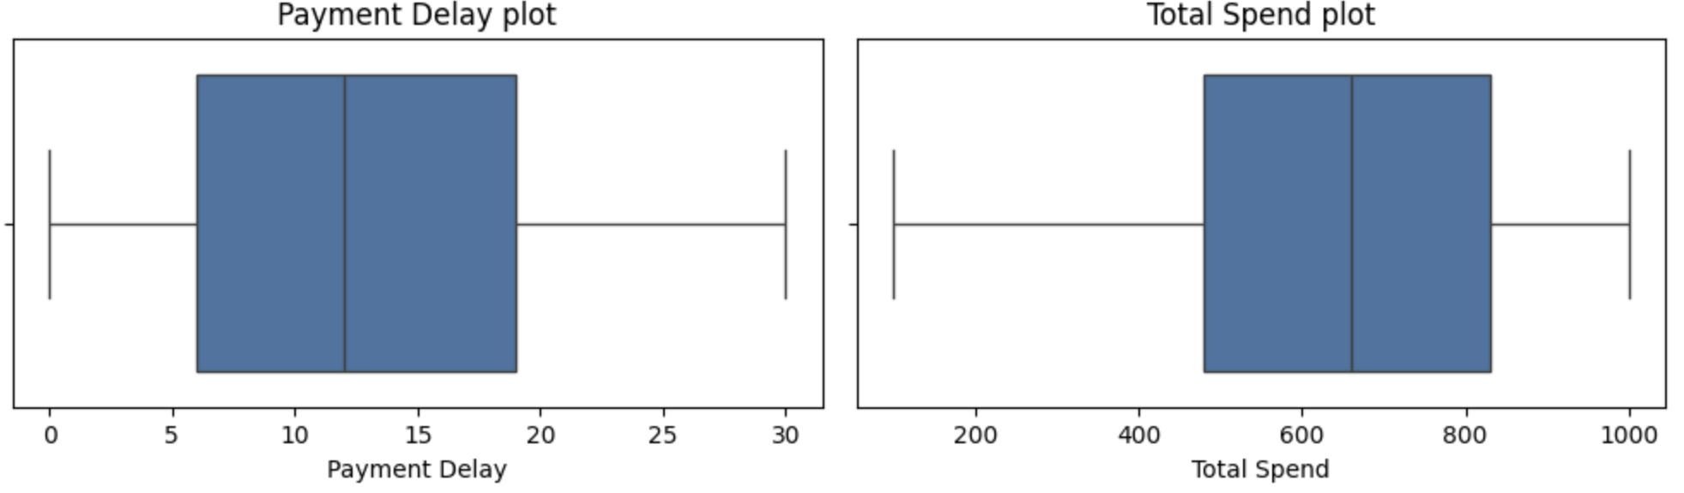
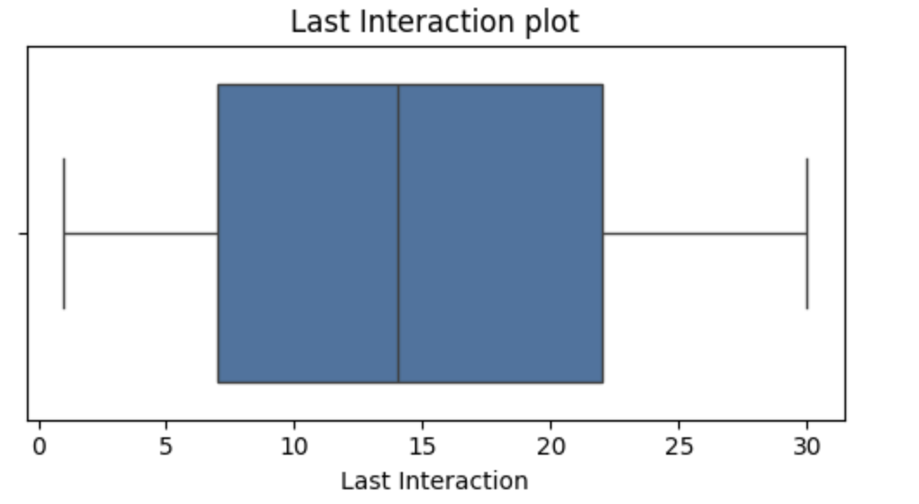
2.2. Data Preparation
In this part, we need to find out all the NA values, duplicate values and outliers
Handle the NA values
There are no duplicated values.
There are no outliers values in numerical feature

Slide 12
03
Exploratory Data Analysis

Slide 13
3. Data Preparation
Target feature
Numerical feature
Describe and analyze the target variable
The distribution and proportion of the target variable values
Frequency and distribution of numerical values.
Descriptive statistics
Categorical feature
Insights and Initial Predictions
Frequency and distribution of categorical values.
Descriptive statistics
Relationships with the target variable
Predict the important features influencing the target variable.

Slide 14
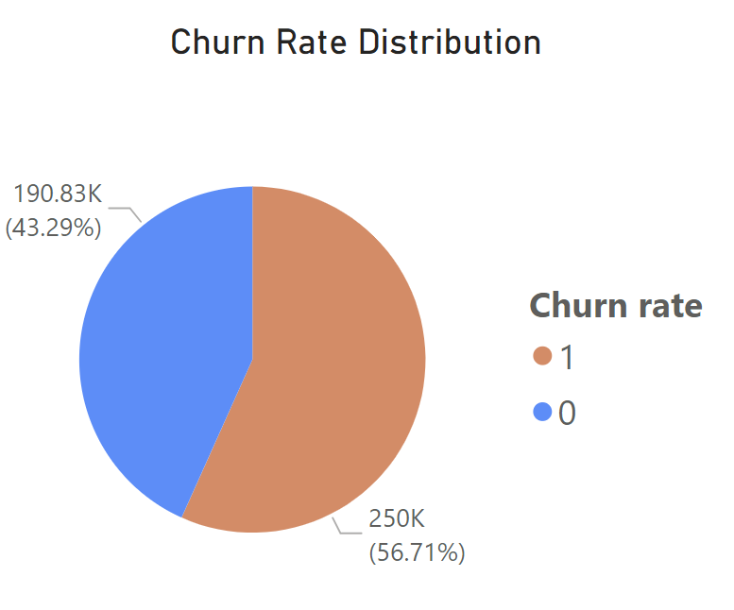
3.2. Numerical Feature
Conclusion:
The churn rate is 13% higher than the non churn rate. This is alarming to the system.
Churn
Not churn

Slide 15
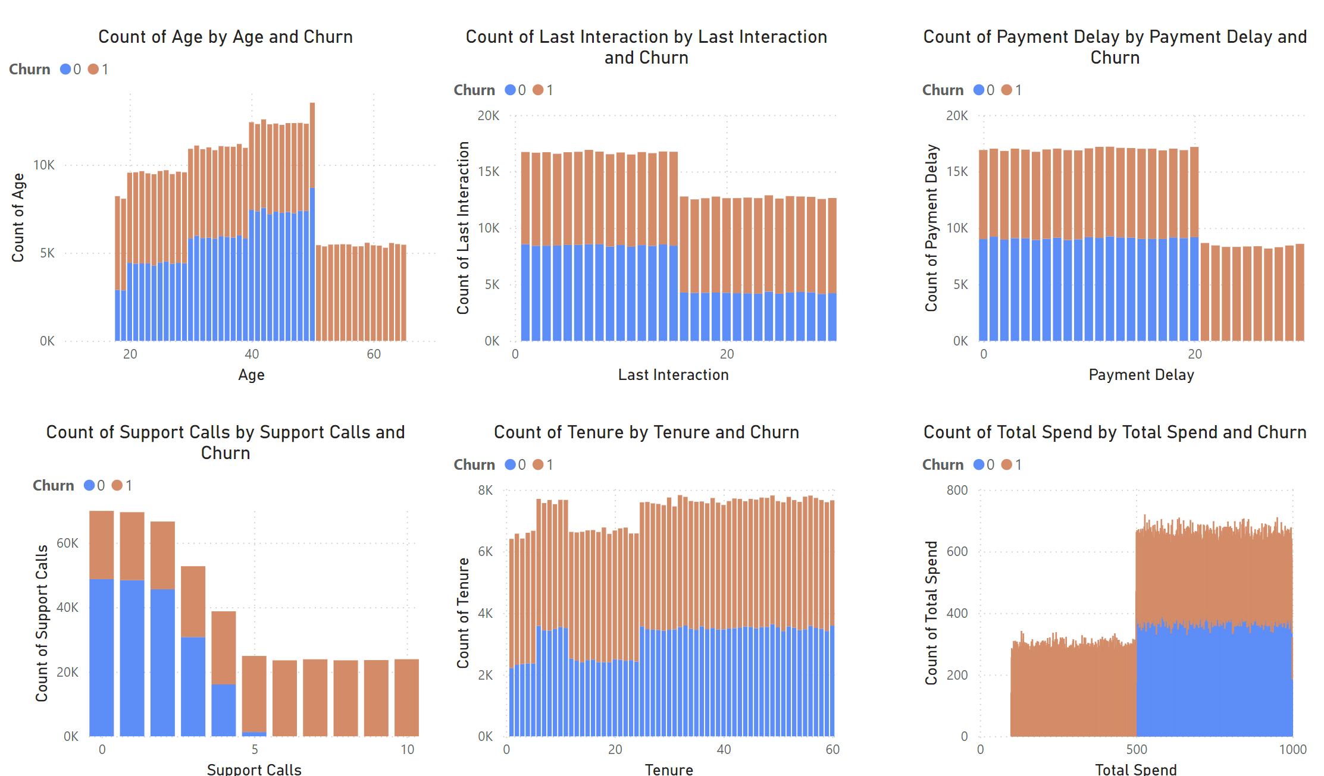
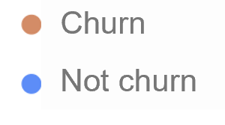
3.2. Numerical Feature
Conclusion:
First, we have to delete the columns : ‘CustomerID’ because this columns is not necessary
Second, look at these histplots, we can see that ‘Age’, ‘Delay’, ‘Support Calls’, ‘Total Spend’ . There is a big difference between churn and not churn. A large amount of value is distributed in the same area, but this is all churn

Slide 16
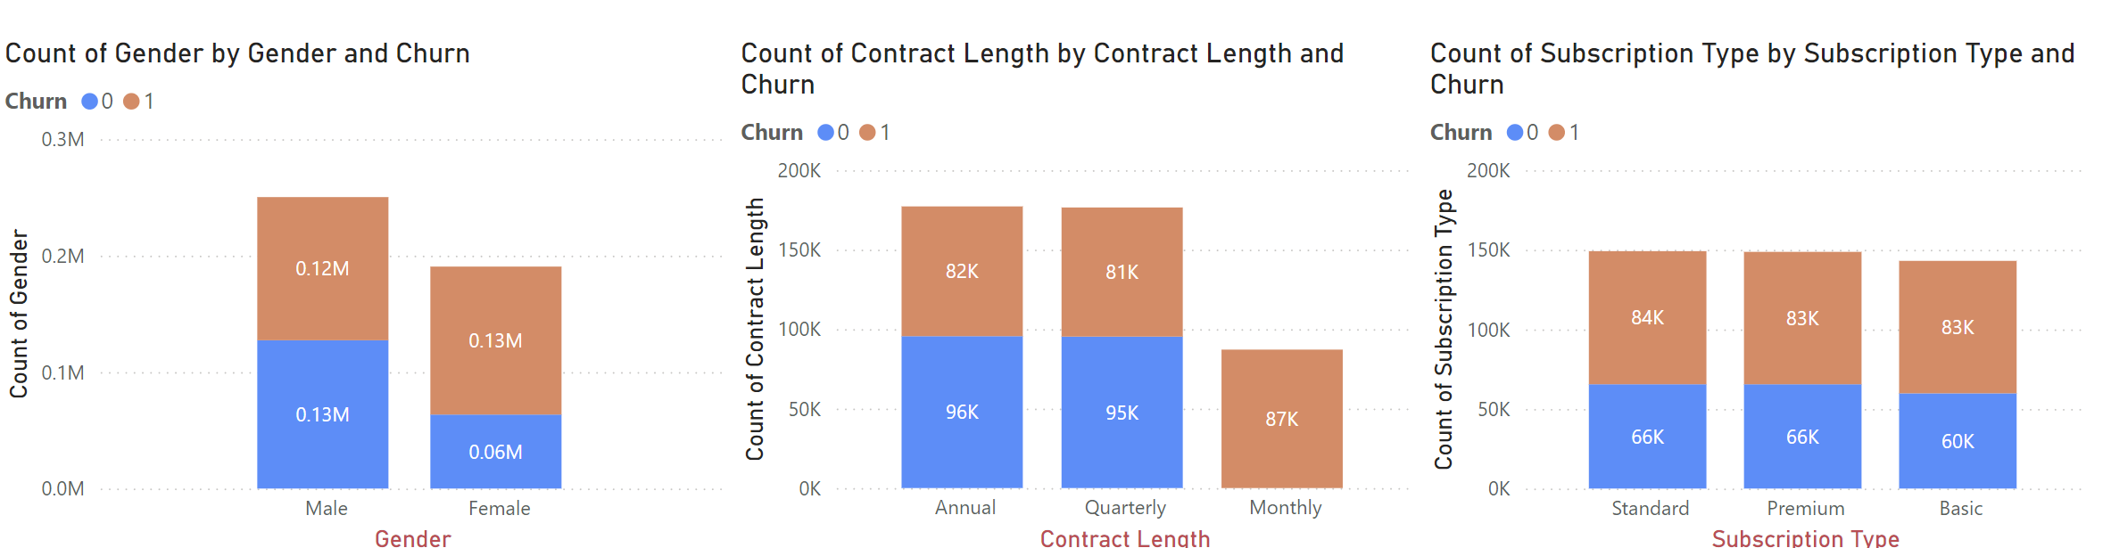
3.3. Categorical Feature
Conclusion:
Some charts have a large difference between churn and not churn
Additionally, there are some features that are almost exclusively churn ('monthly') in contract length

Slide 17
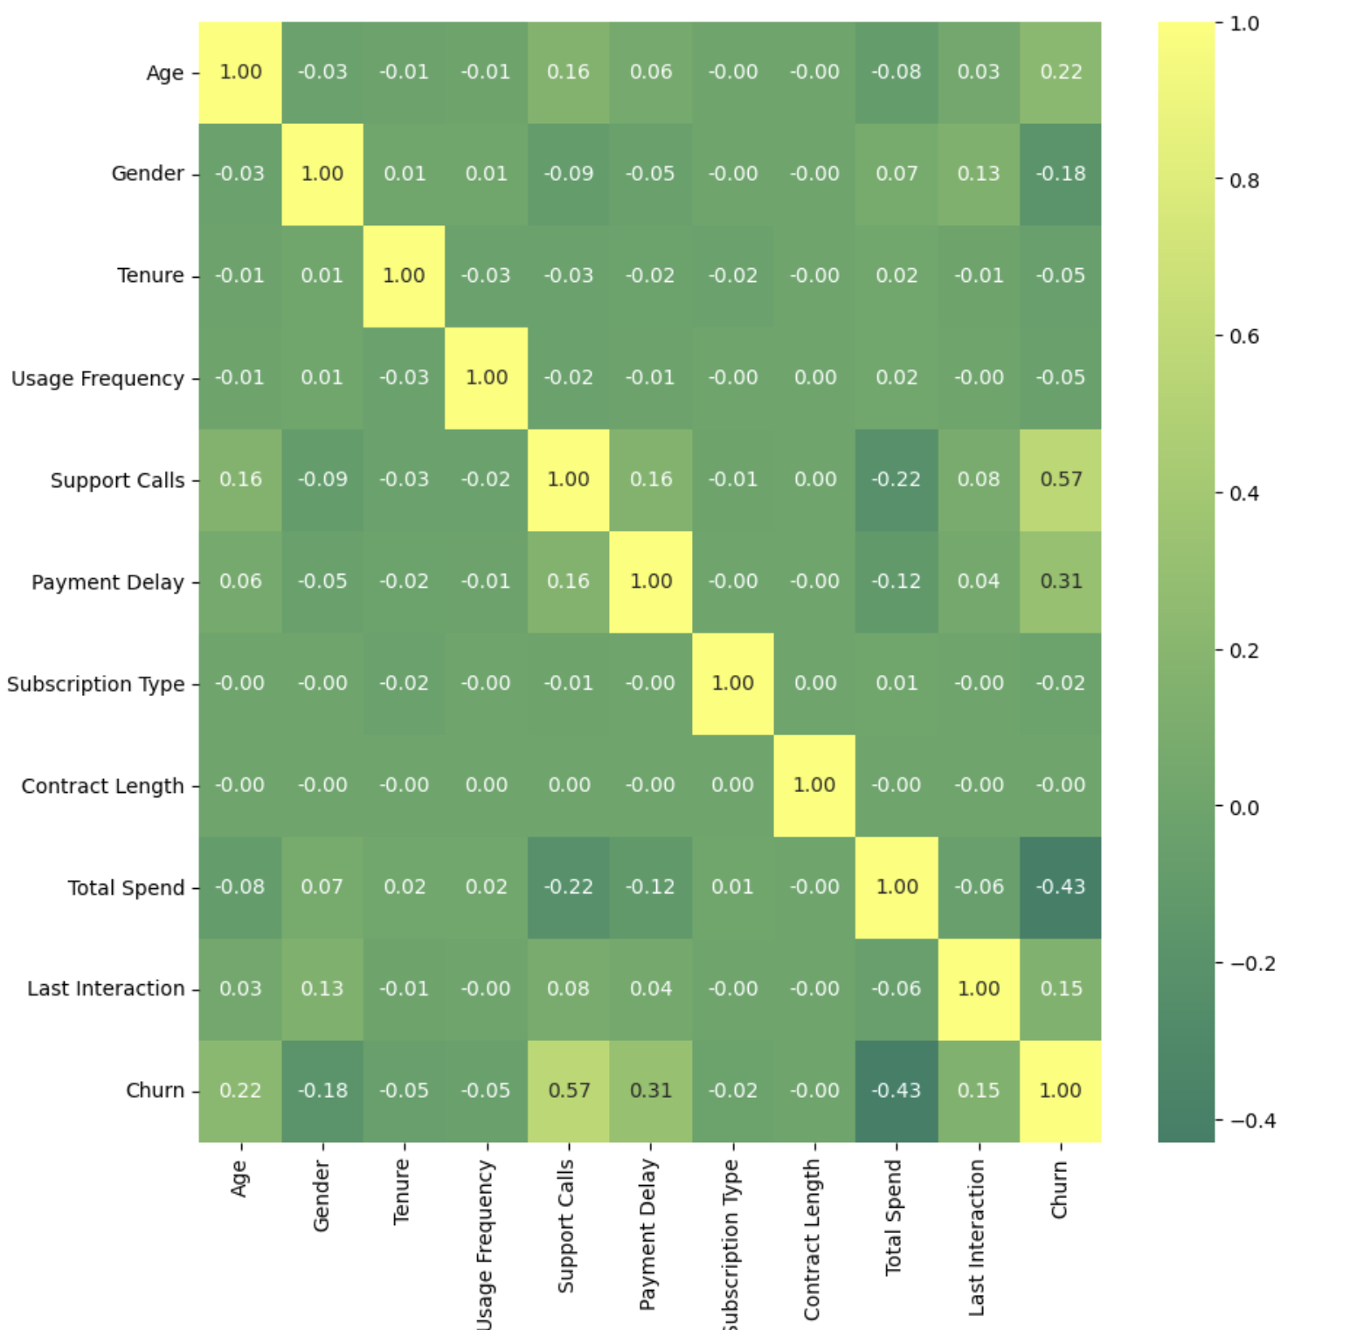
3.4. Insights and Initial Prediction
Conclusion:
Heatmap shows the correlation of independent and dependent variables.
Some of high correlation :
Support Call – Churn
Total Spend – Churn
Payment Delay – Churn
Age – Churn

Slide 18
3.4. Insights and Initial Prediction
Conclusion:
Most customers only make 1 to 4 calls. And the churn rate of this distribution is about 1/3.
For calls of 5 or more, the churn rate is approximately 100%.
-> The cause may come from customers having to face a certain error so many times that they don't want to use the service anymore.

Slide 19
3.4. Insights and Initial Prediction
Conclusion:
- It seems that accumulations below 500 have a churn rate of approximately 100%. For over 500, the ratio is 50-50
-> Perhaps there is something difficult for the customer that makes them feel that this service is not necessary for their income.

Slide 20
3.4. Insights and Initial Prediction
Conclusion:
Payment delays over 20 days have a churn rate of approximately 100%. Under 20 there is a 50-50 ratio
-> Customers who are slow to pay can come from many factors. There are some cases of not being able to pay, leading to churn.

Slide 21
3.4. Insights and Initial Prediction
Conclusion:
Age over 50 year olds have a churn rate of approximately 100%. Under 50 there is 40% churn and 60% is not churn
-> As they age, they may no longer be too interested in financial services. Or because the complexity of the process makes it difficult for them to reach and easy to leave the service

Slide 22
04
Feature Selection & Modeling

Slide 23
4. Feature Selection & Modeling
In-Output & Splitting
Model Selection
Select input(x) and output(y)
Train test split
Select the type of model
Calculating performance metrics
Visualize and select the model
Feature Importance
Model Interpretability
-Calculate and visualize the feature importance
LIME and explaination

Slide 24
4. 1. In – Output & Splitting
Categorical Feature
“Loan Status”
LabelEncoder()
LabelEncoder()
Conclusion:
We need to convert the categorical variables and target variables into binary form to support model analysis

Slide 25
4. 1. In – Output & Splitting
Numerical Feature
Categorical Feature
‘Loan Status’
Input features X
Target Feature
Y
Conclusion:
Input feature is all feature except ‘Loan Status’
Target feature is ‘Loan Status’

Slide 26
4. 1. In – Output & Splitting
Train_test_split()
x_train, x_test
y_train, y_test
StandardScaler()
x_train_scaled
x_test_scaled
Conclusion:
In the previous step, we have change categorical to binary number. So we have to change numerical feature to standard scale

Slide 27
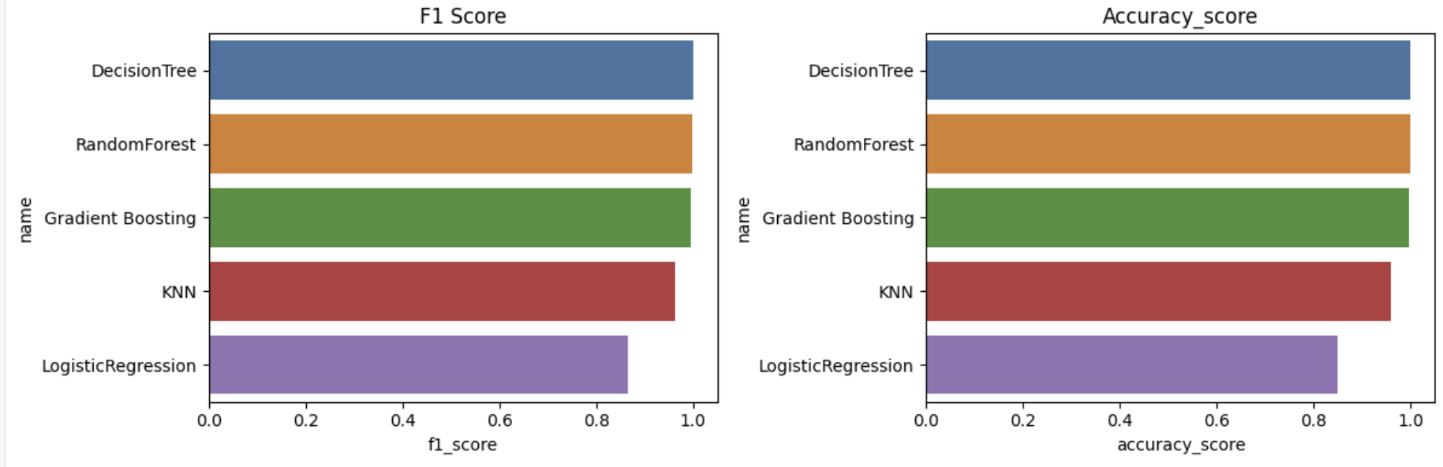
4.2. Model Selection
Conclusion:
It can be seen that the three methods Gradient Boosting, Logistic Regression and Random Forest all have the same and highest results.

Slide 28
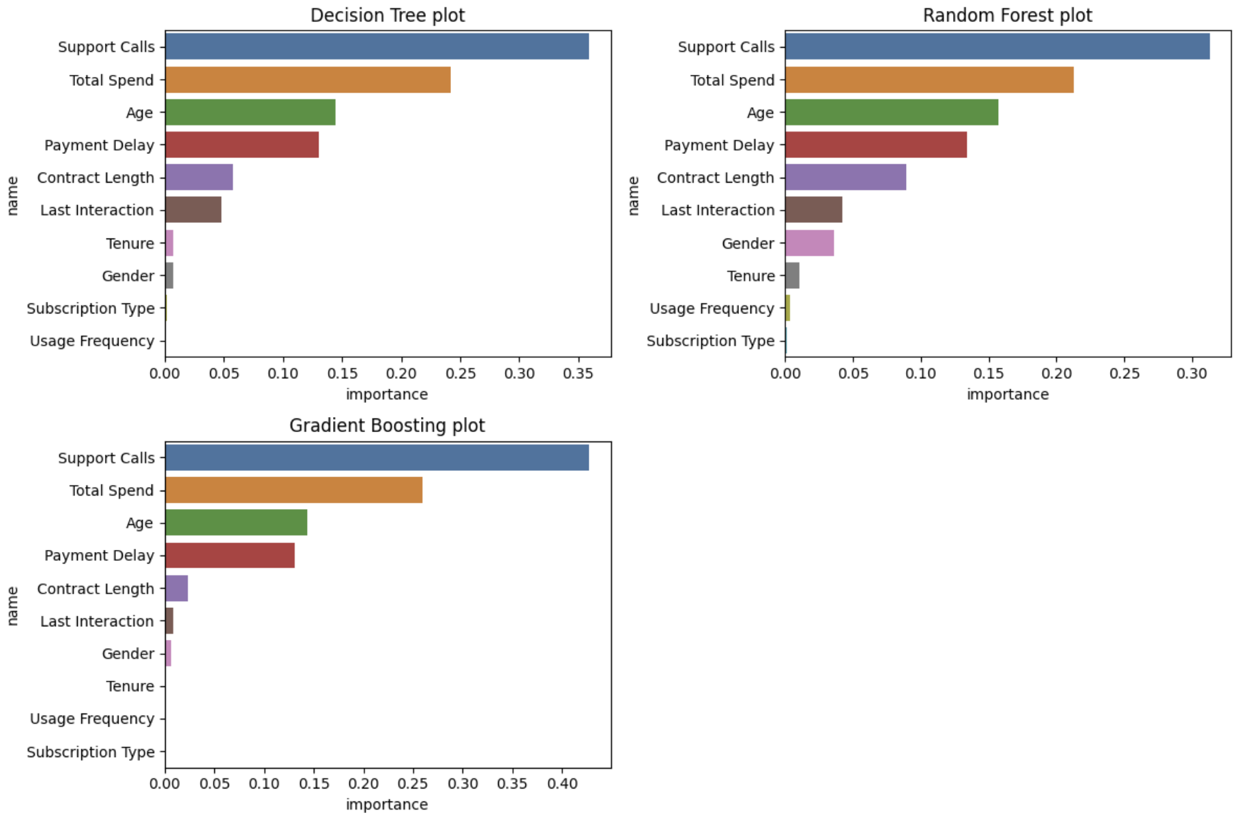
4.3. Feature Importance

Slide 29
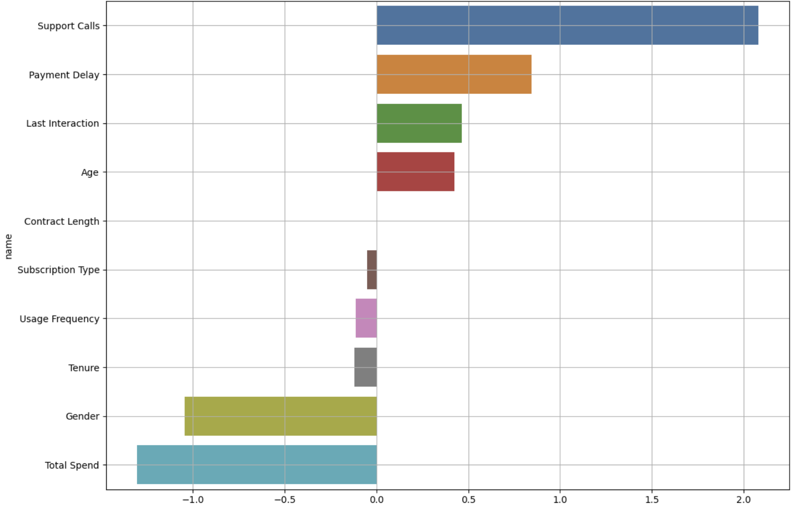
4.3. Feature Importance
Logistic Regression plot

Slide 30
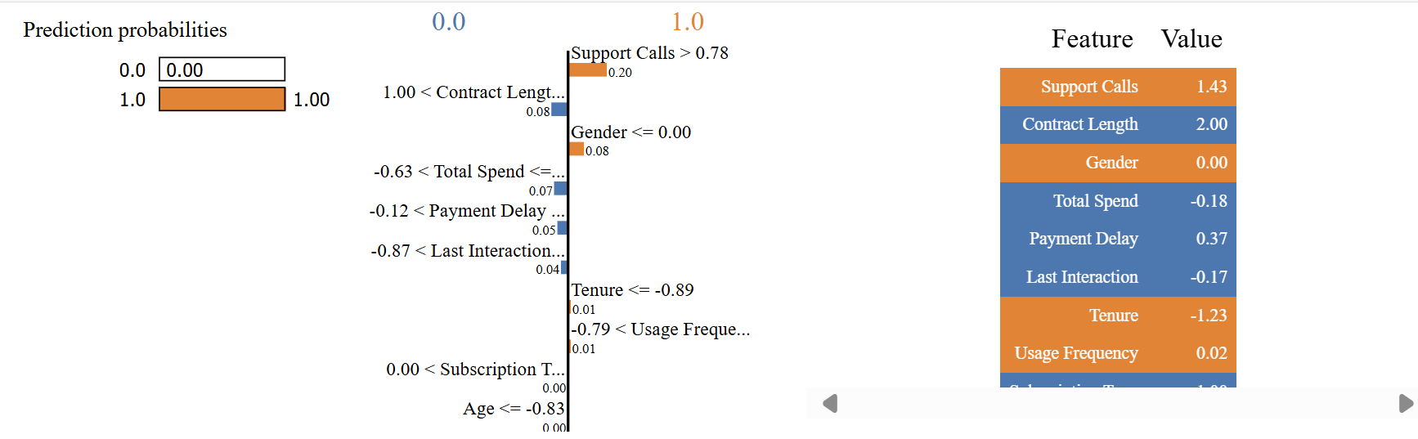
4.4. Model Interpretability
In row [0]:
Support Calls contributes the most to the ‘grade 1’ prediction (0.20)
Contract Lengths contributes the most to ‘grade 0’ (0.08)
Gender contribution to ‘grade 1’: 0.08

Slide 31
05
Results & Future Works

Slide 32
5.1. Results
Conclusion:
Payment delay has the biggest impact on churn/not churn rate. Payment Delays after 20 days have a churn rate of approximately 100%. Below 20, the ratio is 50-50
Total Spend has the second largest influence on churn/not churn rate. For customers spending less than 500, the churn rate is about 100%. Above 500, the ratio is 50-50
Age has a churn rate of approximately 100% for people over 50 years old. Under 50 years old, the churn rate is proportional to the number of participants and accounts for a uniform rate of about 45%.
It can be said that when support call > 5, the churn rate is equivalent to 100%. Less than 5 calls have a churn rate of about 30%.
Support Calls
Age
Payment Delay
Total Spend

Slide 33

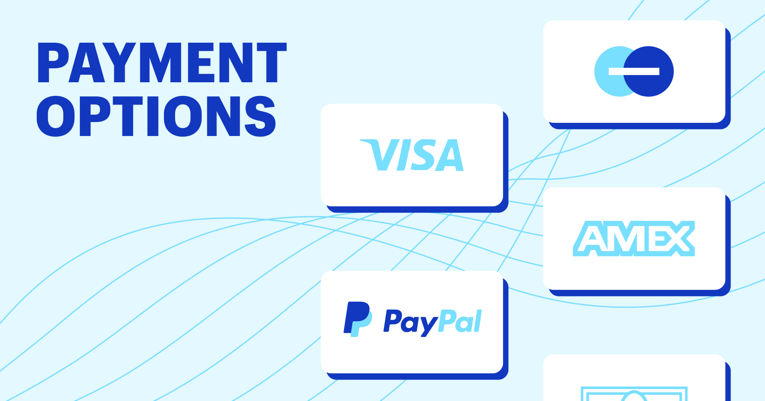
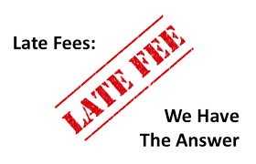

5.2. Future Works
CUSTOMER WHO FORGOT PAYMENT OR CANNOT PAY
Friendly notifications to customers, from 1 to 3 times and gradually increasing warnings according to each level
Supports payment in many forms
Warning and fee deduction if payment is late or other penalties are imposed
Encourage customers to pay early or on time with discounts
Support Calls
Age
Total Spend

Slide 34



5.2. Future Works
CUSTOMER WHO HAS LOWER INCOME
Reduced service fees (if any) in addition to a small monthly support, or a shopping voucher for customers with income under $500
Create Personal Relationships: Develop personal relationships with customers by understanding their needs and desires, thereby providing appropriate and timely services.
Build customer loyalty programs with many benefits and incentives to encourage customers to continue using the service.
Age
Total Spend

Slide 35



5.2. Future Works
ELDERLY CUSTOMERS HAVE DIFFICULTY USING THE SERVICE
Personal Support Services: Provide personal support services at the counter or over the phone to help elderly customers easily access and use banking services.
Savings and Retirement Products: Develop savings and retirement products with attractive interest rates and flexible terms, suitable for the needs of the elderly.
Age

Slide 36

5.2. Future Works
IMPROVE THE SUPPORT CALL AND PROBLEM RELATED
Improve the Quality of Support Services : Train customer support staff in problem solving, listening and communication skills to handle calls effectively and quickly.
Analyze customer feedback and thoroughly handle customer problems. Limit repetitive processing

Slide 37
Thanks!
Do you have any questions?
youremail@freepik.com
+34 654 321 432
yourwebsite.com
Please keep this slide for attribution

